Slide 1
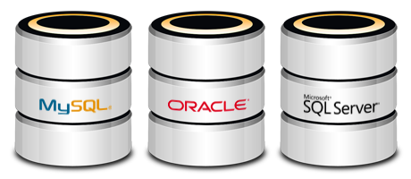
Database Management
Gaddam Snigdha
Sravya Madarapu
Sai Naveen
Sridhar
Taruni Bollu
Sanjana Somisetty
Vamsi Krishna
Saichaitanya Rudra
Workshop 5

Slide 2




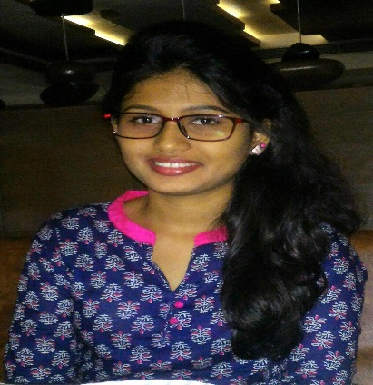



Team
Snigdha Gaddam
Sravya Madarapu
Naveen mallampati
Sridhar Yerasi
Taruni Bollu
Sanjana Somisetty
Vamsi Krishna
Saichaitanya Rudra

Slide 3
Overview
Persistence options
Process for making architectural data choices
Data storage/persistence options to use
Choices made for each application
Other appropriate options
Demo

Slide 4
Persistence
Ability of an object to survive the lifetime of the OS process in which it resides
Persistent storage can be
Relational Database
Non – Relational Database
Snigdha Gaddam

Slide 5
Relational Database
It refers to set of tables containing data fitted into predefined categories
Virtually all RDBS use Structured Query Language (SQL) as the language of querying and maintaining the database
The reasons for dominance are
Simplicity Robustness Flexibility
Performance Scalability Compatibility
Snigdha Gaddam

Slide 6
Oracle Database
Object-relational database management system
Collection of data treated as a unit
Tracks computer storage with the help of info stored in SYSTEM tablespace
Snigdha Gaddam

Slide 7
MySQL
SQL Server
Runs as a server providing multi user access to a number of databases
Free source
It requires very less disk space
Is a database computer language designed for managing data
Closed source
It requires more disk space
Snigdha Gaddam

Slide 8

What is NoSQL?
Scalability
Vertically
Add more data
Horizontally
Add more storage
Collection of structures
Hash tables, maps, dictionaries
No pre-defined schema
No join operations
Sravya Madarapu

Slide 9
BASE (Basically Available, Soft state, Eventual consistency), as opposed to ACID
Basic availability – system can run even if parts have failedg
Via replication
Soft state: copies of a data item may be inconsistent
Eventually Consistent – copies becomes consistent at some later time if there are no more updates to that data item
Sravya madarapu

Slide 10
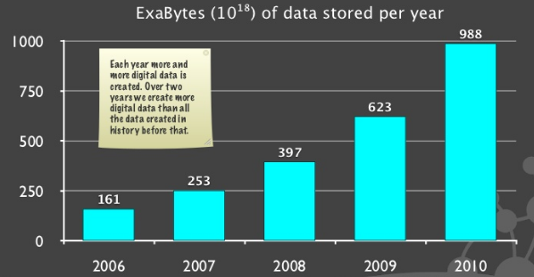
Why NOSQL now?
Trend 1 – Data Size
Trend 2 – connectedness
Trend 3 – Architecture
Trend 1 – Data Size – Each year more and more digital data is created. Over 2 years we created more digital data than all data created in history before
Sravya Madarapu

Slide 11
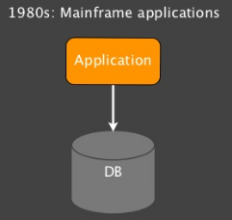
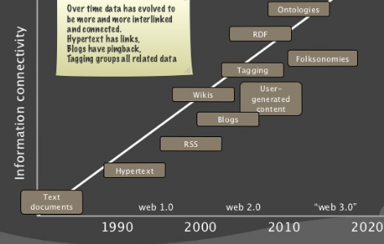
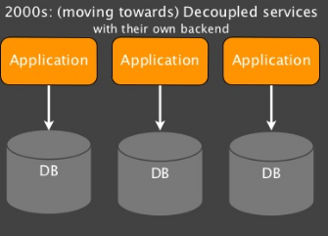
Cont…
Trend 2 – Over the time data has more interlinked and connected. Hypertext have links
Trend 3 - Architecture
Sravya Madarapu

Slide 12
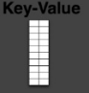
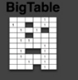
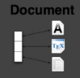
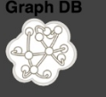
NOSQL Options
Sravya Madarapu

Slide 13
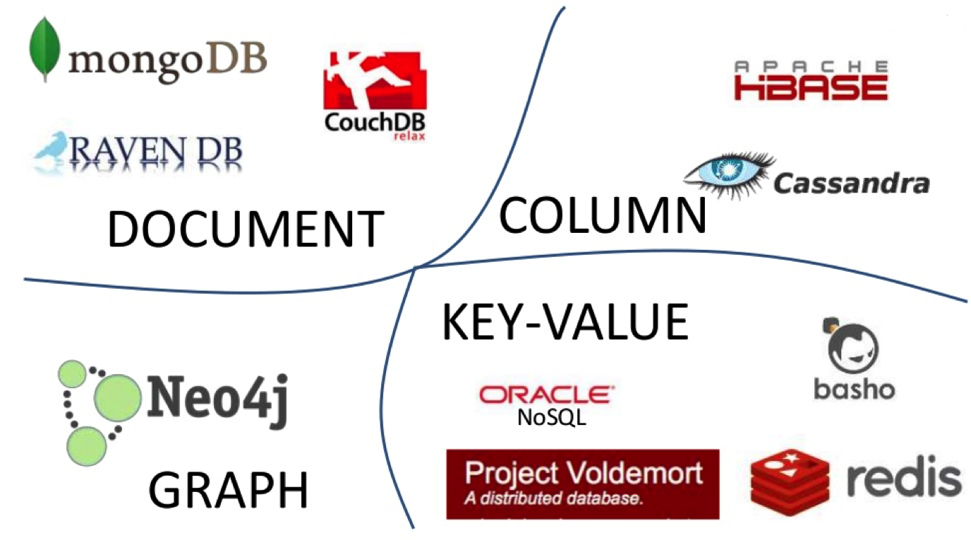
NOSQL Options contd..
Sravya Madarapu

Slide 14
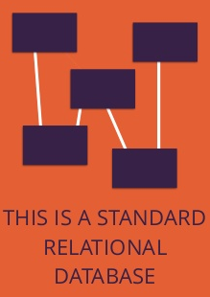
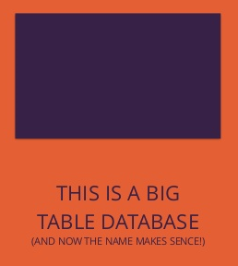
Big table
Big table is sparse distributed multi dimensional storage map the map is indexed by a row key and a column key and a timestamp.
Examples
Cassandra
Hbase
Amazon Simple DB
Sravya Madarapu

Slide 15
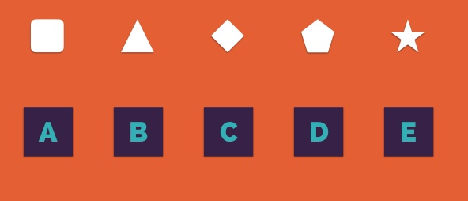
Key value
These data bases are designed to work with large data
Values are inside the keys
If we want the value we have to query the key
Redis DB
Sravya Madarapu

Slide 16
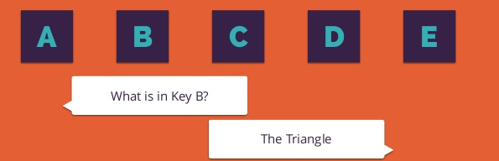
Key value contd..
Sravya Madarapu

Slide 17
Document store
This are designed to work with more data
Document data stores feature the ability to store documents into a database.
The structure of documents (their fields) is dynamic and can be freely modified by the client with the ability to add or remove fields of existing documents.
Similar to key value database
Main difference is that you can actually see the values.
Examples – MongoDB , Couch DB
Sravya Madarapu

Slide 18
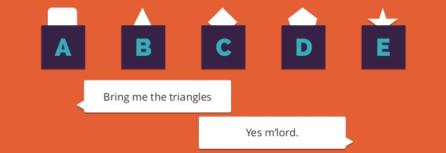
Document store contd..
Sravya Madarapu

Slide 19
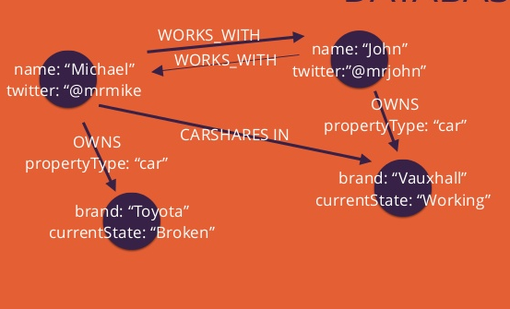
Graph db.
Focus here is modelling of structure data
Inspired by graph theory
Example
Neo4j
Sravya Madarapu

Slide 20
MongoDB
Document Oriented Database
Open Source Technology
Scalable, High performance, Easy to use.
Sai Naveen Mallampati

Slide 21
MongoDB(Cont..)
Databases contains collections.
Documents are stored in collections.
Documents are in BSON format consisting of field-value pairs.
Documents have uniform structure.
Sai Naveen Mallampati

Slide 22
MongoDB(Cont…)
BSON Example
{
"_id" : "37010"
"city" : "ADAMS",
"pop" : 2660,
"state" : "TN",
“councilman” : {
name: “John Smith”
address: “13 Scenic Way”
} }
Sai Naveen Mallampati

Slide 23
CouchDB
Open source database developed by Apache Foundation.
Contains documents stored in JSON format.
It has HTTP-based REST API to communicate with database.
Sai Naveen Mallampati

Slide 24
Primary difference
Process for making your architectural data choices
SQL is digital. It works best for clearly defined, discrete items with exact specifications.
Typical use cases are online stores and banking systems.
NoSQL is analog. It works best for organic data with fluid requirements.
Typical use cases are social networks, customer management and web analytics systems.
Sridhar

Slide 25
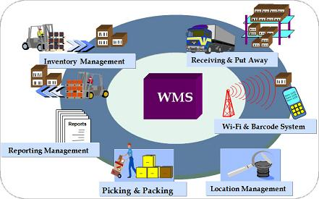
Scenario One: a Warehouse Management System
Sridhar

Slide 26
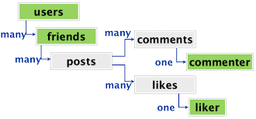
Scenario Two: a Social Network
Sridhar

Slide 27
It has the feature set with options such as relationship links, status updates, messaging and “likes”.
Most data updates have a single point of origin: the user.
It’s unlikely we’ll need to update two or more records at any one time, so transaction-like functionality is not required.
The application’s interface and performance take a higher priority than robust data integrity.
Sridhar

Slide 28
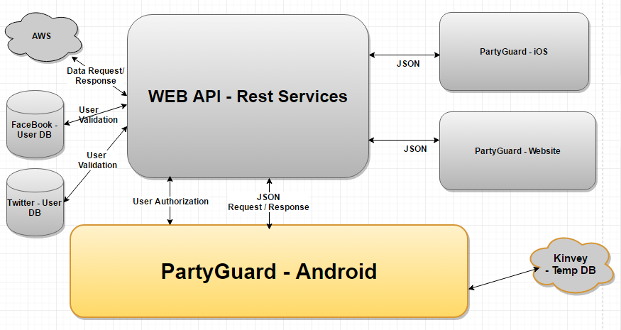

Slide 29
Graph Database
Online database management system with Create, Read, Update and Delete (CRUD) operations working on a graph data model
Employs nodes, edges and properties
Relationships take first priority in graph databases
Used by Tech giants like Google, Facebook, LinkedIn and PayPal1
Taruni Bollu
Notes:
Tech giants like Google, Facebook, LinkedIn and PayPal all tapped into the power of graph databases to create booming businesses. Their secret? They each used graph database technology to harness the power of data connections.

Slide 30
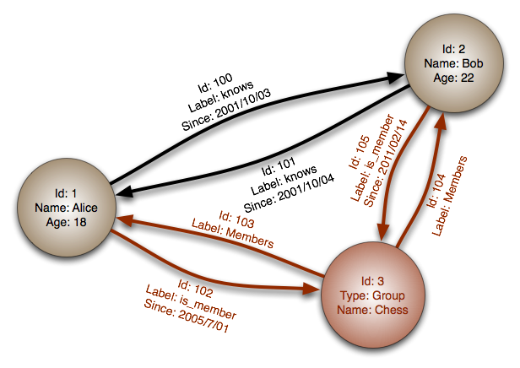
Graph database diagram:
Taruni Bollu
Notes:
Nodes: Entities such as people, businesses, accounts, or any other item you might want to keep track of
Edges: Also known as graphs or relationships, are the lines that connect nodes to other nodes; they represent the relationship between them
Properties: Information that relate to nodes

Slide 31
Properties:
Graph Storage
Graph Processing Engine
Taruni Bollu
Notes:
Graph storage: Some graph databases use native graph storage that is specifically designed to store and manage graphs, while others use relational or object-oriented databases instead. Non-native storage is often much more unused.
Graph Processing Engine: Native graph processing (a.k.a. “index-free adjacency”) is the most efficient means of processing graph data since connected nodes physically “point” to each other in the database. Non-native graph processing uses other means to process CRUD operations.

Slide 32
How did you decide what data storage/persistence options to use?
Reviews and Usage
Space Factor
Time Factor
Taruni Bollu

Slide 33
Comparative Study and guidelines
Core functionality is the important part for any project.
Most of these core functionality features depend on backend databases or services.
So, selecting the correct backend database or services is very important.
Sanjana Somisetty

Slide 34
Cont…
Consider PartyGuard Application.
We have many database services to choose from like SQLite database(android), Kinvey mBaaS, Java RESTful webservices, Microsoft Azure, etc.
Sanjana Somisetty
Notes:
mBaas – mobile Backend as a Service

Slide 35
Guidelines and Drawbacks
SQLite DB – easy to access but less storage capacity.
Kinvey mBaaS – only 1GB free storage. A single DB cannot be accessed from different OS.
Java RESTful services - REST API ends up requiring very complex and domain-bound XML or JSON POSTs.
Microsoft Azure – educational account is only free for six months.
Sanjana Somisetty

Slide 36
Guidelines and Drawbacks (Cont.)
At first, decided to use JAVA RESTful services with Spring.
Problems faced
Very time taking
Manual procedures
The route url has to be created manually and published.
Sanjana Somisetty
Notes:
Spring has more no of libraries when compared to other 3rd party services.
Server connections have to be done manually.

Slide 37
Microsoft Azure
Route URL is automatically created.
Easy to use.
Ability to Scale on Demand
Flexibility
Sanjana Somisetty

Slide 38

Vamsi Krishna Pendyala

Slide 39
Design goals
Highly Available with Strong Consistency
Provide access to data in face of failures/partitioning
Durability
Replicate data several times within and across regions
Scalability
Need to scale to zettabytes
Provide a global namespace to access data around the world
Automatically scale out and load balance data to meet peak traffic demands
Vamsi Krishna Pendyala

Slide 40
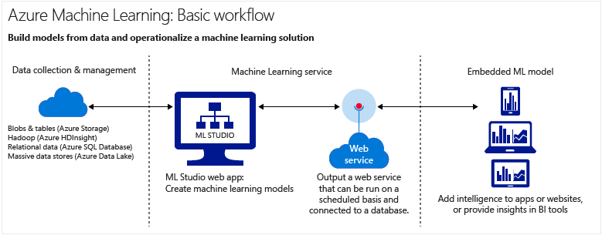
Workflow
Vamsi Krishna Pendyala

Slide 41
Examples
Xbox: Uses Blobs, Tables & Queues for Cloud Game Saves, Halo 4, XBox Music, XBox Live, etc.
Bing: Uses Blobs, Tables and Queues to provide a near real-time ingestion engine that consumes Twitter and Facebook feeds, indexes them, which is then folded into Bing search
Vamsi Krishna Pendyala

Slide 42
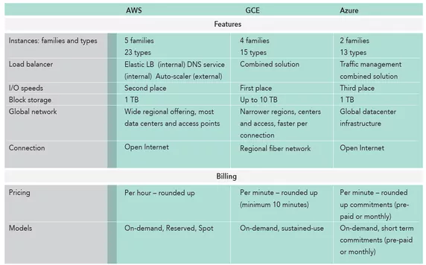
Other cloud storages
Vamsi Krishna Pendyala

Slide 43

Connections to database and storing the JSON data into MongoDB
Sai Chaitanya Rudra

Slide 44
Thank you ☺
Questions ?

